Slide 2
ARM Yourself with Bicep
Eduard Keilholz
Cloud Solution Architect
NIC X Edition
June 1 2022

Slide 3
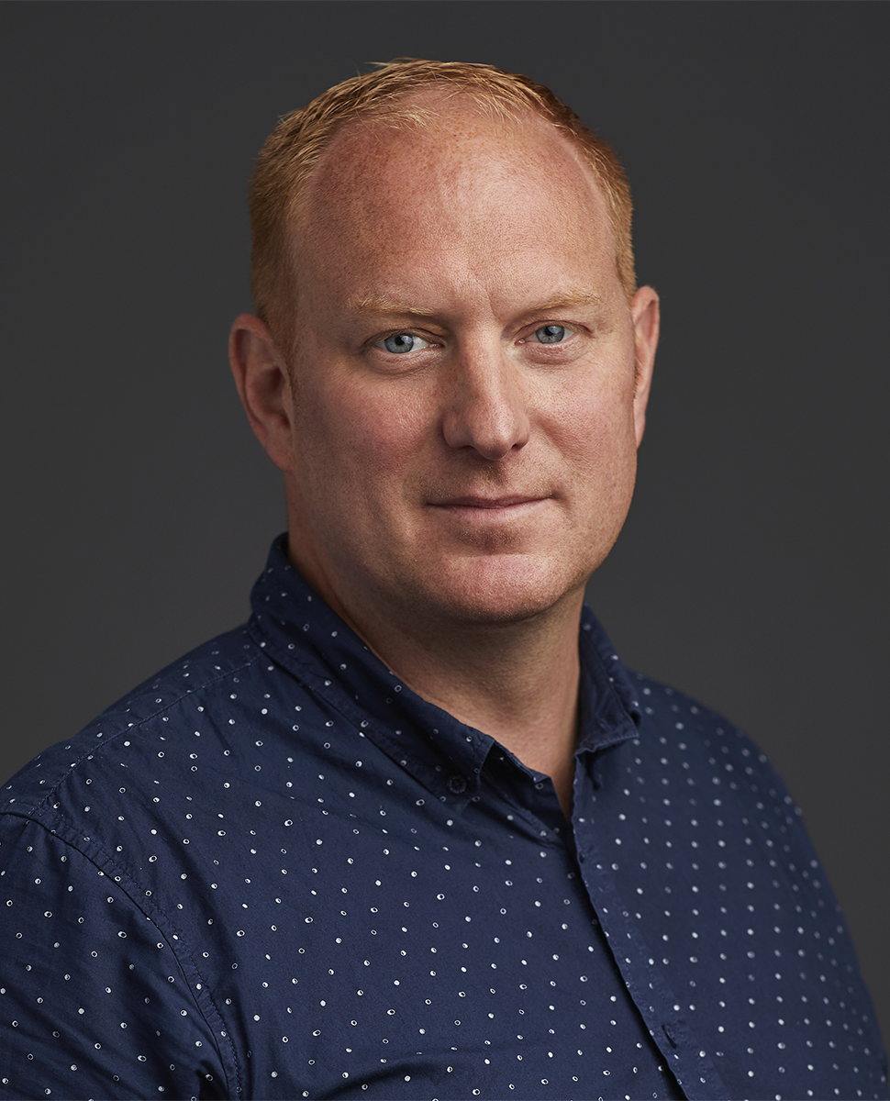

Eduard Keilholz
Cloud Solution Architect
I am a Cloud Solution Architect at 4DotNet (The Netherlands). I focus is on the Microsoft development stack, mainly C# and the Microsoft Azure Cloud.
https://www.linkedin.com/in/eduard-keilholz/
@ed_dotnet
https://github.com/nikneem

Slide 4

WHY
Do you want infrastructure as code?
Picture by Abraham Berrera - Unsplash
Notes:
Prevent human error
Too much permissions on prod
Audittable & Reviewable
Easy rebuild & tear down

Slide 5
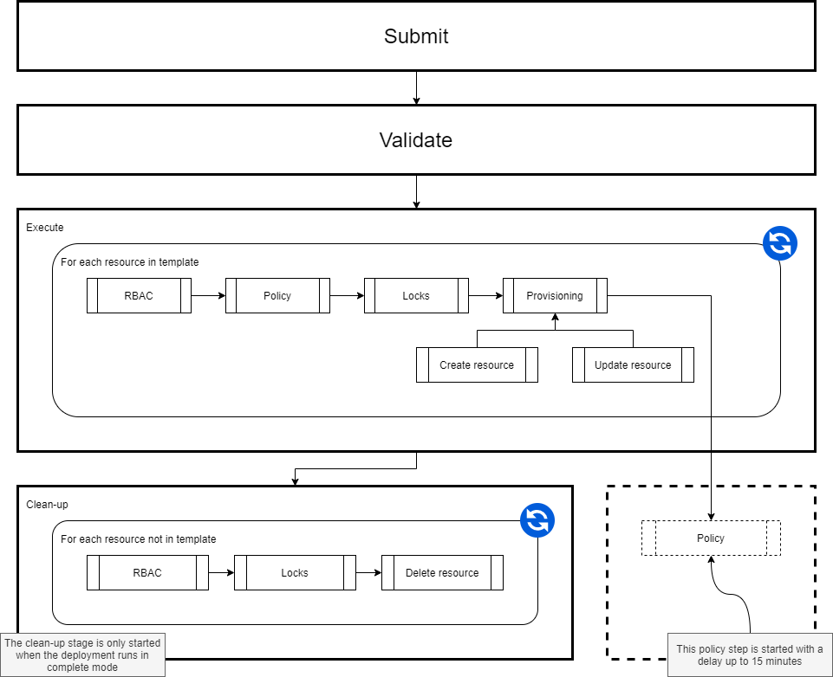
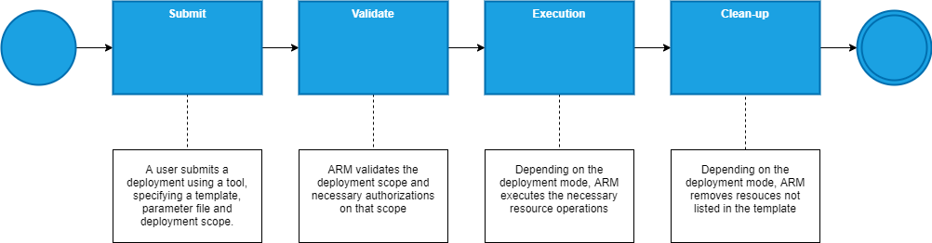
The Azure Resource Manager
Notes:
Prevent human error
Too much permissions on prod
Audittable & Reviewable
Easy rebuild & tear down

Slide 6

How does Bicep work?
resource storageAccountX ‘storageAccount’ = {
name: ‘storageAccountName’
location: resourceGroup().location }
{
"$schema": "https://../deploymentTemplate",
"contentVersion": "1.0.0.0",
"resources": [],
}
ARM
Resource Provider
Notes:
Transpile Bicep to ARM Template
Present to ARM
Resource provider creates storage account

Slide 7
Why do you need Bicep?
Dodge limitations of JSON
String interpolation
Lots of ceremony
Fixed positions for declarations
Overcome challenges of linked templates
Tooling
Way too large files

Slide 8
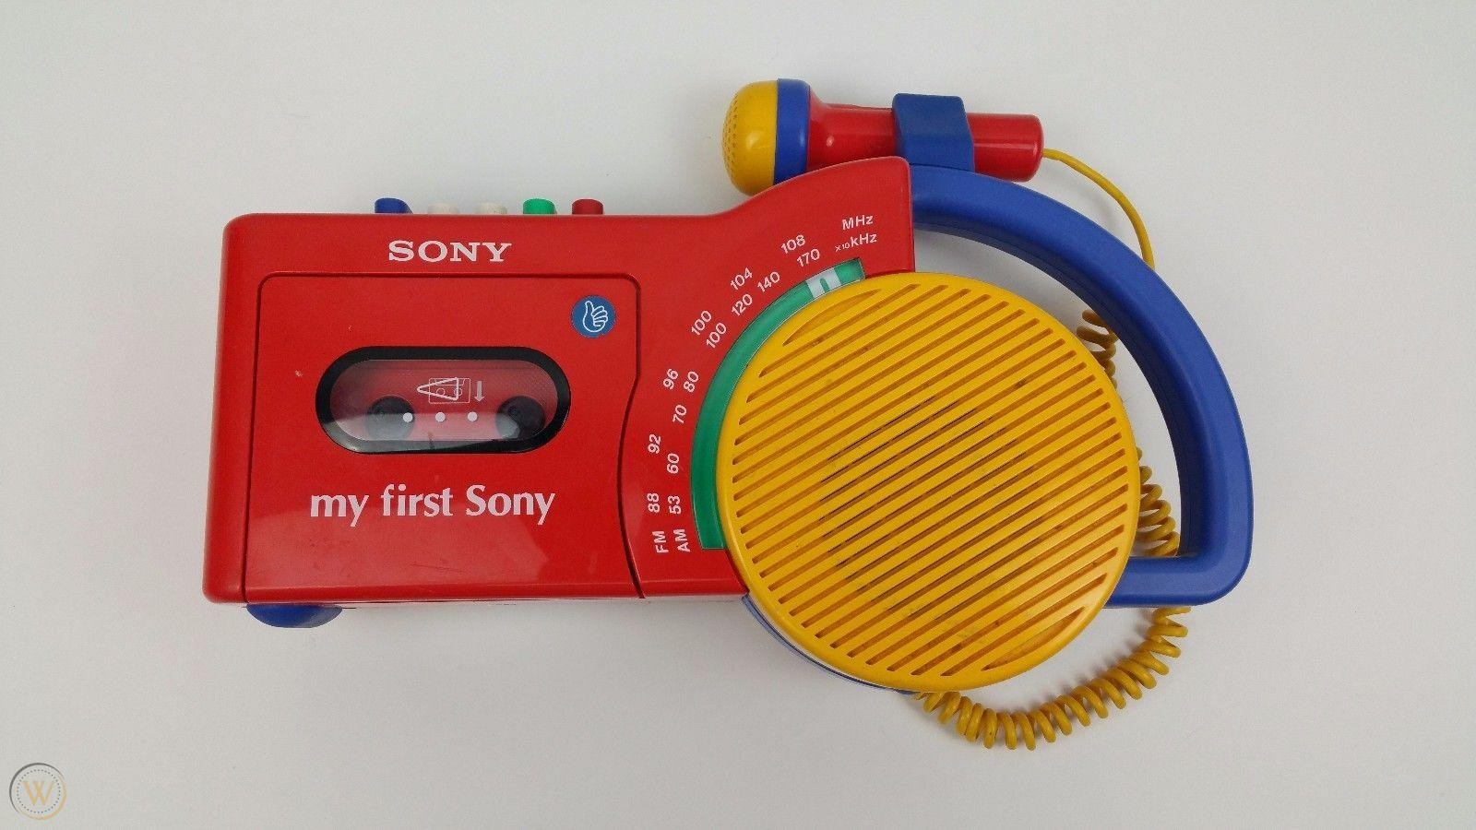
My First Bicep
{
"$schema": "https://schema.management.azure.com/schemas/2019-04-01/deploymentTemplate.json#",
"contentVersion": "1.0.0.0",
"resources": [
{
"type": "Microsoft.Storage/storageAccounts",
"apiVersion": "2021-06-01",
"name": "mystorageaccountname",
"location": "[resourceGroup().location]",
"kind": "StorageV2",
"sku": {
"name": "Standard_LRS"
}
}
]
}
resource storageAccountResource 'Microsoft.Storage/storageAccounts@2021-06-01' = {
name: 'mystorageaccountname'
location: resourceGroup().location
kind: 'StorageV2'
sku: {
name: 'Standard_LRS'
}
}

Slide 9
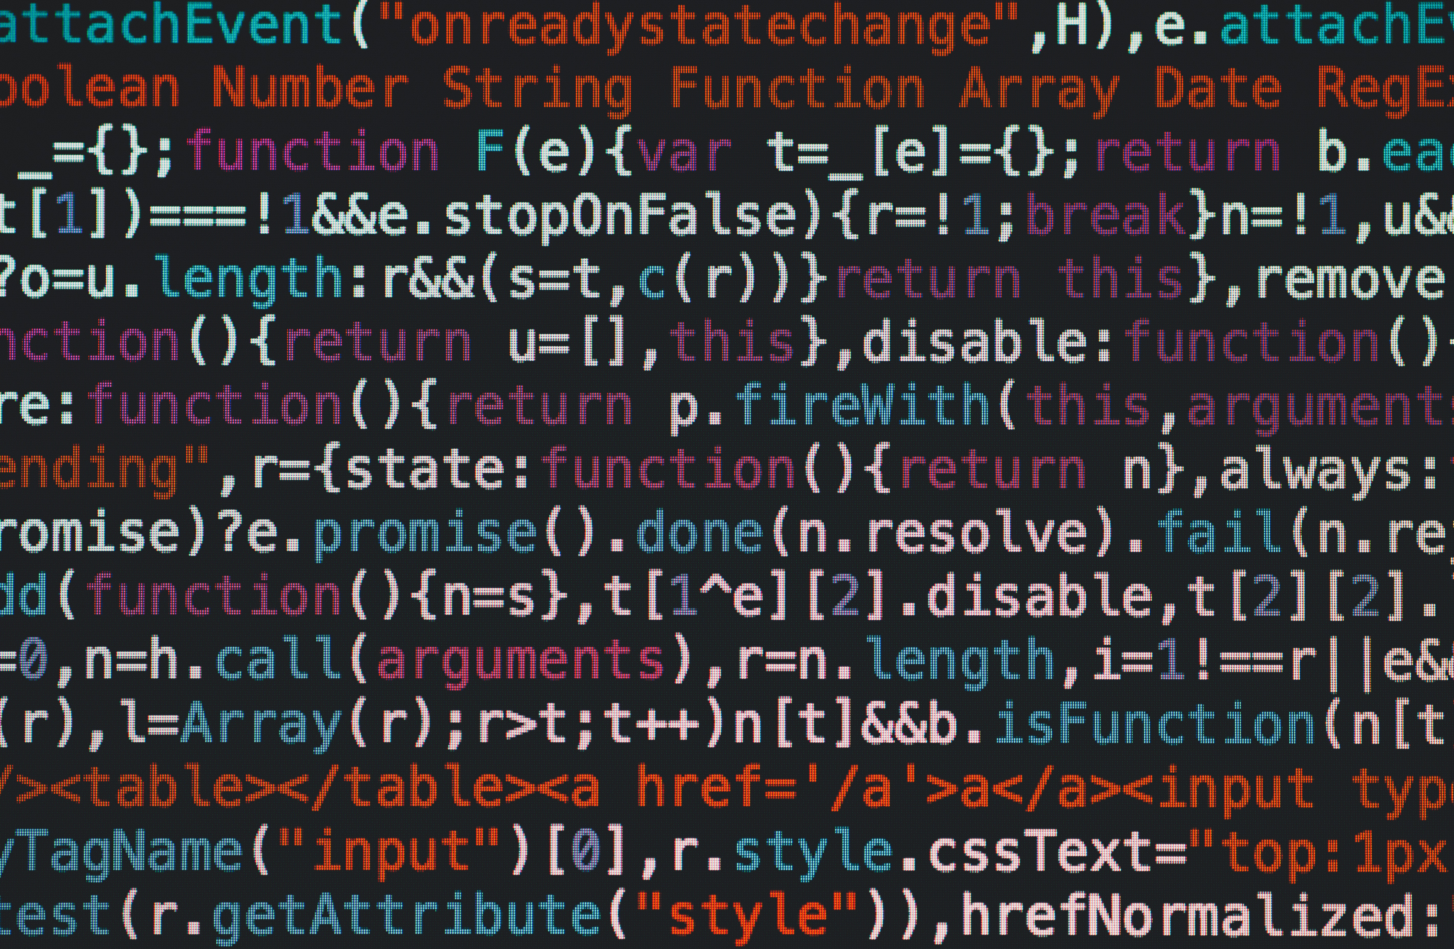
Demo 1

Slide 10
Parameters and variables
param systemName string
@allowed([
'dev'
'test'
'prod'
])
param environmentName string
@secure()
param superSecretPassword string
{
"$schema": "https://path-to/schema.json#",
"contentVersion": "1.0.0.0",
"parameters": {
"environmentName": {
"value": "prod"
}
}
}
var defaultResourceName = '${systemName}-${environmentName}'
var blobContainers = [
'uploadedpictures'
'scaledpictures'
'thumbnails'
]
Notes:
Parameters are JSON files (runtime)
Parameter decorators

Slide 11
Modules
path/file.bicep
module module1 ‘path/file.bicep' = {
name: ‘module1'
params: {
}
}
module module2 ‘path/file2.bicep' = {
name: ‘module2'
params: {
}
}
resource res ‘resource@apiversion' = {
location: resourceGroup().location
name: ‘resourcename’
properties: {}
}
path/file2.bicep
resource res ‘resource@apiversion' = {
location: resourceGroup().location
name: ‘resourcename’
properties: {}
}
Notes:
Parameters are JSON files (runtime)
Parameter decorators

Slide 12
Outputs
module module1 ‘path/file.bicep' = {
name: ‘module1'
params: {
}
}
module module2 ‘path/file2.bicep' = {
name: ‘module2'
params: {
name: module1.outputs. name
}
}
resource res ‘resource@apiversion' = {
location: resourceGroup().location
name: ‘resourcename’
properties: {}
}
output name string = res.name
param name string
resource res ‘resource@apiversion' = {
location: resourceGroup().location
name: ‘resourcename’
properties: {}
}
Notes:
Parameters are JSON files (runtime)
Parameter decorators

Slide 13
Demo 2

Slide 14

Functions & Loops
Picture by Shahadat Rahman - Unsplash
Notes:
String functions
Scope functions
Iterate through arrays

Slide 15
Demo 3

Slide 16
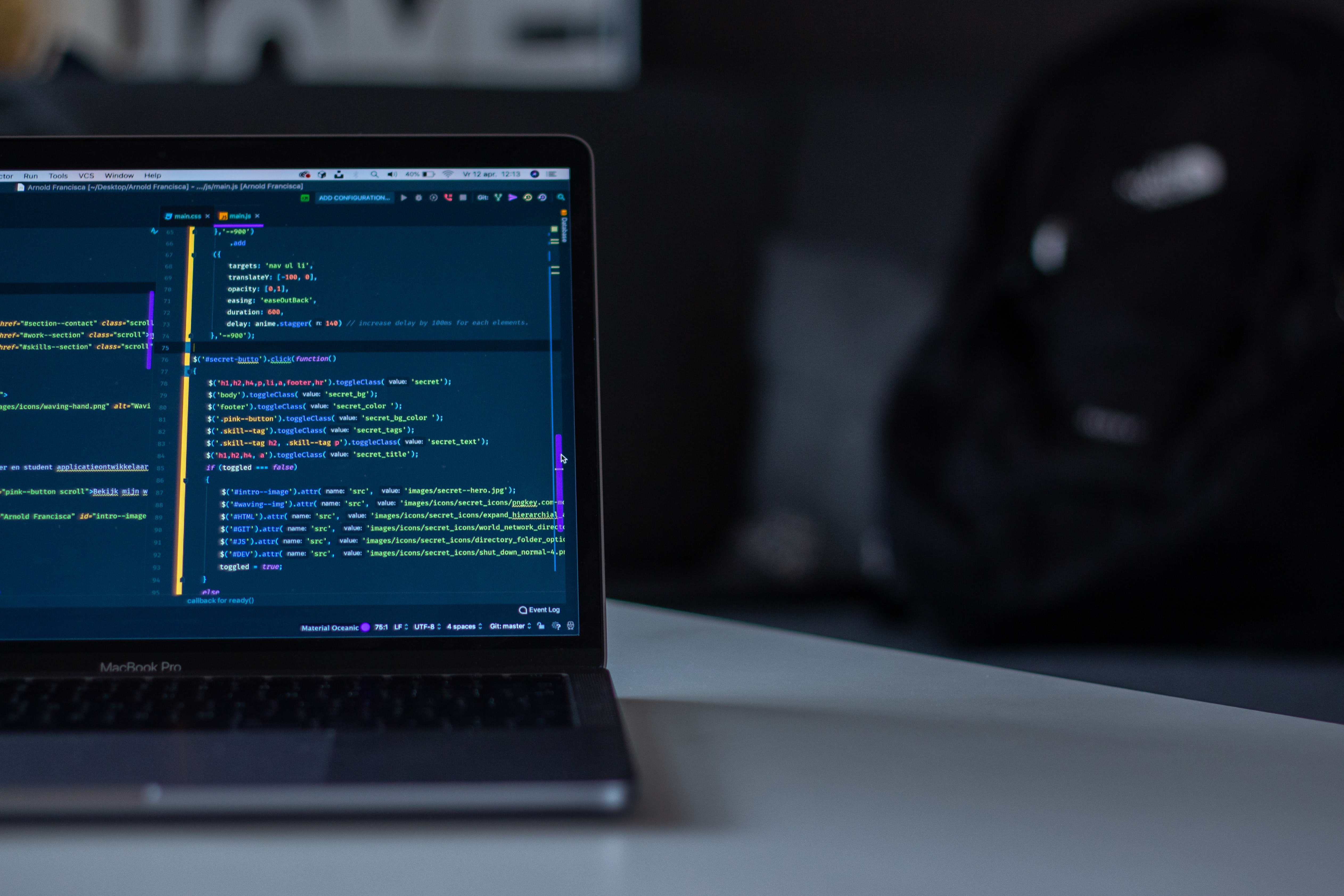
Real-world example
Picture by Arnold Francisca - Unsplash
Notes:
String functions
Scope functions
Iterate through arrays

Slide 17
Demo 4

Slide 18

Re-use of templates
Picture by Evgeny Karchevsky - Unsplash
Notes:
String functions
Scope functions
Iterate through arrays

Slide 19
Demo 5

Slide 20
Eduard Keilholz
Thank you, questions?
http://mng.bz/qYj2
35% Discount code
ctwnicxed22
https://www.linkedin.com/in/eduard-keilholz/
@ed_dotnet
https://github.com/nikneem

Slide 21
Slides and demos from the conference will be available at
https://github.com/nordicinfrastructureconference/2022
https://github.com/nikneem/bicep-demos

